Slide 1
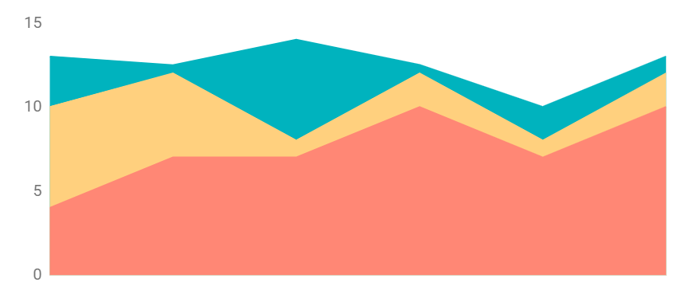
Flat Dashboard Infographics
$265
$159
$158
Mars is actually a cold place
Earth is where we all live on
Pluto is an icy dwarf planet
300
200
100
50%
75%
0
Mercury
Saturn
Mercury is the smallest planet
It’s a gas giant and has rings
Jan
Feb
Mar
Apr
May
Jun
To modify this graph, click on it, follow the link, change the data and paste the new graph here

Slide 2
Flat Dashboard Infographics
Jupiter
Mercury
Mercury
563
Venus
Mon
Tue
Wed
Thu
Fri
Sat
Sun
Venus
Mars
Earth
980
Neptune
Earth
Earth
Jupiter
Venus
50%
Mars
Mars
Mars
10%
Venus
Venus
1 156

Slide 3
Generos Musicales mas escuchados
Tipo de genero
Generos mas escuchados por Pais
Mercury
563
Venus
Rock
Pop
Clasico
Jazz
Blues
980
Neptune
Earth
Earth
Jupiter
Venus
50%
Mars
Mars
Mars
10%
Venus
Venus
1 156

Slide 4
Flat Dashboard Infographics
Mars
Earth
Mars is actually a cold place
Earth is where we all live on
25K
Pluto is an icy dwarf planet
35%
15
18
13
29
15
17
Jupiter
Venus
Mercury
Venus has a beautiful name
35%
45%
65%
Saturn
It’s a gas giant and has rings
60%
Mercury is the smallest planet
10
20
30
40
50
60

Slide 5
Flat Dashboard Infographics
7
8
Venus
Mars
266K
6
6
Jupiter is the biggest planet
3
2
Mars
Earth
S
M
T
W
T
F
S
75%
Venus has a beautiful name
Venus
30%
Saturn
90%
65%
30%
16%
$56K
Mars
45%
Neptune
50%
Mars is a cold place
Jupiter
Saturn
Mercury

Slide 6
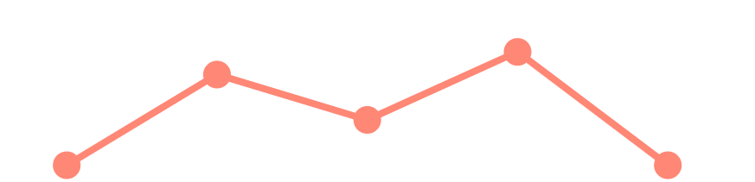
Flat Dashboard Infographics
Mercury
Venus
Neptune
Mercury is the smallest planet
Mars
Mars is actually a cold place
May
Jun
Jul
Aug
Sep
Earth
Venus
To modify this graph, click on it, follow the link, change the data and paste the new graph here
Mars
Pluto
Mars
1 566
Venus
4 562
Earth
2 698
Pluto
3 185
Mars
Mars is actually a cold place
Mercury
Venus
26.09.20
Venus has a beautiful name
It’s the smallest planet in the Solar System
Earth
Earth is where we all live on

Slide 7
Flat Dashboard Infographics
Earth
Venus
265 985 156
Mercury
+8%
300
200
70%
$568
100
Earth is where we all live on
0
Jan
Feb
Mar
Apr
May
Neptune
Jupiter
+25%
01
02
Mercury
Pluto
Mars
256 598
Mercury is the smallest planet
Pluto is an icy dwarf planet
$568,562
Venus
659 854

Slide 8
Flat Dashboard Infographics
Jupiter
Saturn
Venus
Mars
Jupiter is the biggest planet
It’s a gas giant and has rings
Venus has a beautiful name
Mars is actually a cold place
Neptune
Earth
Pluto
Saturn
Venus
Mars
Earth

Slide 9
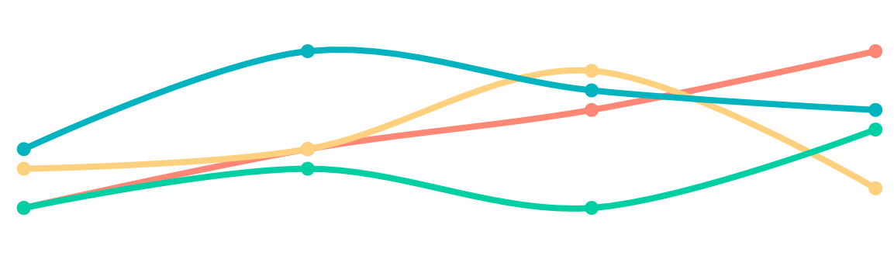
Flat Dashboard Infographics
Mars
20%
M
T
W
T
F
S
S
1
2
3
4
5
6
7
Venus
10%
8
9
10
11
12
13
14
Earth
Jupiter
50%
15
16
17
18
19
20
21
22
23
24
25
26
27
28
Saturn
20%
29
30
31
Jupiter is the biggest planet
Venus has a beautiful name
Mars is actually a cold place
Earth is where we all live on
To modify this graph, click on it, follow the link, change the data and paste the new graph here

Slide 10
Flat Dashboard Infographics
Neptune is very far away
Neptune
+20%
Earth is where we all live on
Earth
+5%
Mercury is the smallest planet
Mercury
+90%
Saturn
Mars
It’s a gas giant and has rings
Mars is actually a cold place
Jupiter
Venus
Jupiter is the biggest planet
Venus has a beautiful name
Neptune
4/7
Mercury
5/7
Earth
6/7
Pluto
3/7

Slide 11
Flat Dashboard Infographics
Jupiter
+25%
Mars
+10%
Neptune
+5%
23%
48%
Jupiter
Venus
Jupiter is the biggest planet
Venus has a beautiful name
Venus
Venus has a beautiful name
19%
10%
Saturn
Mars
It’s a gas giant and has rings
Mars is actually a cold place
Venus
Mars
Earth

Slide 12
Flat Dashboard Infographics
Venus
Venus has a beautiful name
80%
70%
ASDASD
Mars is actually a cold place
50%
Earth is where we all live on
ASFASF
30%
01
02
03
Jupiter
Saturn
Neptune
Jupiter is the biggest planet
It’s a gas giant and has rings
Neptune is very far away

Slide 13
Flat Dashboard Infographics
60%
Saturn
Jupiter
Neptune
75%
Mars
Jupiter is the biggest planet
Neptune is very far away
70%
Neptune
30%
40%
45%
50%
45%
10%
45%
45%
Earth
Venus
40%
25%
15%
Earth is where we all live on
Venus has a beautiful name
10%
Venus
Mars
Earth

Slide 14
Flat Dashboard Infographics
Saturn
Jupiter
It’s a gas giant and has rings
Jupiter is the biggest planet
Venus
Venus has a beautiful name
Neptune
Neptune is very far away
It’s a gas giant and has rings
Neptune
Saturn
Mercury
Mercury is the smallest planet
M
T
W
T
F

Slide 15
Flat Dashboard Infographics
156,156
158,962
159,365
597,412
It’s a gas giant and has rings
Mars is actually a cold place
Jupiter is the biggest planet
Venus has a beautiful name
70%
40%
85%
45%
70%
50%
Venus
Mars
Earth
Mercury
1
2
3
4
5
6
7

Slide 16
Flat Dashboard Infographics
300
40%
200
30%
50%
100
0
20%
60%
Jan
Feb
Mar
Apr
May
Jun
Venus
Mars
Earth
10%
70%
80%
Mercury
Mercury is the smallest planet
Neptune
Neptune is very far away
Mars
Mars is actually a cold place

Slide 17
Flat Dashboard Infographics
300
30%
Jupiter
25%
Jupiter is the biggest planet
200
15%
18%
100
Saturn
0
It’s a gas giant and has rings
Jan
Feb
Mar
Apr
May
Jupiter
Saturn
Mars
Venus
Jupiter is the biggest planet
It’s a gas giant and has rings
Mars is actually a cold place
Venus has a beautiful name

Slide 18
Flat Dashboard Infographics
Jupiter
+25%
$568,562
$568
Earth is where we all live on
Mercury
+10%
$246
$125,687
It’s a gas giant and has rings
Venus
Mars
Earth

Slide 19
Flat Dashboard Infographics
1
3
Jupiter
Saturn
Jupiter is the biggest planet
Saturn has several rings
2
4
Venus
Mars
Venus has a beautiful name
Mars is a cold place
1
2
3
4
100%
80%
60%
Mars
40%
Venus
20%
2014
2015
2016
2017
2018
2019

Slide 20
Flat Dashboard Infographics
A
50%
B
75%
C
25%
D
60%
30%
Mars
80%
Venus
20%
Jupiter
Jupiter
Saturn
Jupiter is the biggest planet
It’s a gas giant and has rings
90%
Saturn

Slide 21
Flat Dashboard Infographics
Saturn
Jupiter
27%
2018
2019
2020
Venus
Jupiter
Jupiter
Saturn
Jupiter is the biggest planet
It’s a gas giant and has rings
Saturn

Slide 22
Flat Dashboard Infographics
Jupiter
75%
Jupiter
Mars
Mars
87%
Venus
50%
Neptune
M
T
W
T
F
S
S
1
2
3
4
5
6
7
8
9
10
11
12
13
14
15
16
17
18
19
20
21
22
23
24
25
26
27
28
Saturn
Jupiter
Venus
Mars
29
30
31

Slide 23
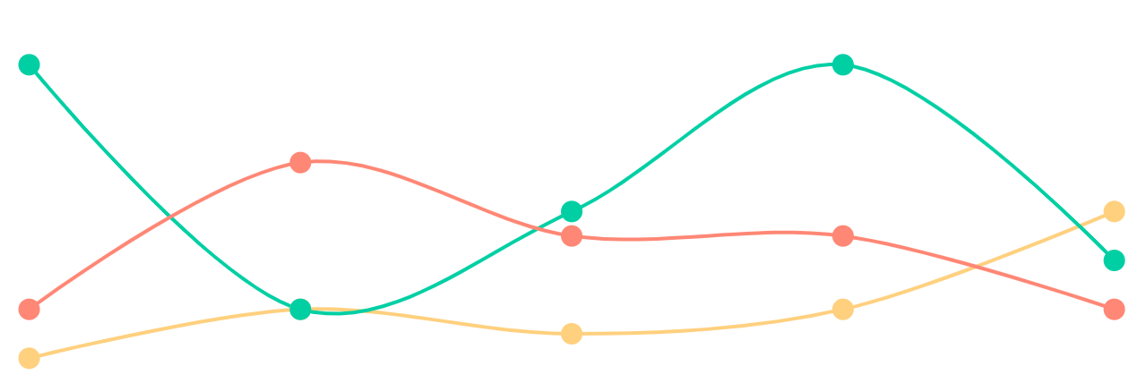
Flat Dashboard Infographics
300
Mars
200
Venus
Jupiter
100
To modify this graph, click on it, follow the link, change the data and paste the new graph here
0
Jan
Feb
Mar
Apr
May
125,946
157,954
365,789
Jupiter is the biggest planet
Venus has a beautiful name
Mars is actually a cold place

Slide 24
Flat Dashboard Infographics
Jupiter
Venus
Neptune
Mars
Neptune
+156
+985
Jupiter
85%
Jupiter
85%
Saturn
40%
Saturn
40%
+569
Jupiter is the biggest planet
Venus has a beautiful name
Venus
50%
Venus
50%
Saturn
Earth
85%
75%
50%
25%
75%
Venus
Mars

Slide 25
Flat Dashboard Infographics
Jupiter
Venus
Neptune
Saturn
Neptune
85%
$156,159
$158,123
$589,621
Venus
70%
Jupiter is the biggest planet
Venus has a beautiful name
Neptune is very far away
Mars
35%
Saturn
Mars
Jupiter
Venus
Neptune
Jupiter
Venus
Pluto
Neptune
Pluto is an icy dwarf planet
1
2
3
4
5
6

Slide 26
Flat Dashboard Infographics
125,695
259,634
259,634
Jupiter
Mars
Neptune
Jupiter is the biggest planet
Mars is actually a cold place
Neptune is very far away
75%
Jupiter
Venus
60%
50%
30
20
10
Jupiter
0
Saturn
1
2
3
Jan
Feb
Mar
Apr
May
Jupiter
30%
Jupiter
30%
Saturn
60%
Saturn
60%
Jupiter
50%
Jupiter
50%

Slide 27
Flat Dashboard Infographics
Earth
Earth
70%
Mars
Mars
60%
Venus
Venus
30%
20%
Jupiter
Neptune
Jupiter is the biggest planet
Neptune is very far away
01
02
03
04
Saturn
Jupiter
Earth
Venus
Earth is where we all live on
Venus has a beautiful name
Venus
Mars

Slide 28
Flat Dashboard Infographics
Jupiter
01
02
03
Mercury
Mercury is the smallest planet
40%
Pluto
50%
Pluto is an icy dwarf planet
Mon
Tue
Wed
Thu
Fri
Sat
Sun
70%
Venus
Mars
Earth
Mercury

Slide 29
Flat Dashboard Infographics
Jupiter
+25%
27%
32%
72%
$568,562
300
Jupiter
Venus
02
Jupiter is the biggest planet
Venus has a beautiful name
200
03
04
100
01
Saturn
Mars
0
It’s a gas giant and has rings
Mars is actually a cold place
10
20
30
40
50
60

Slide 30
Instructions for use (free users)
In order to use this template, you must credit Slidesgo by keeping the Thanks slide.
You are allowed to:
Modify this template.
Use it for both personal and commercial purposes.
You are not allowed to:
Sublicense, sell or rent any of Slidesgo Content (or a modified version of Slidesgo Content).
Distribute this Slidesgo Template (or a modified version of this Slidesgo Template) or include it in a database or in any other product or service that offers downloadable images, icons or presentations that may be subject to distribution or resale.
Use any of the elements that are part of this Slidesgo Template in an isolated and separated way from this Template.
Delete the “Thanks” or “Credits” slide.
Register any of the elements that are part of this template as a trademark or logo, or register it as a work in an intellectual property registry or similar.
For more information about editing slides, please read our FAQs or visit Slidesgo School:
https://slidesgo.com/faqs and https://slidesgo.com/slidesgo-school

Slide 31
Instructions for use (premium users)
In order to use this template, you must be a Premium user on Slidesgo.
You are allowed to:
Modify this template.
Use it for both personal and commercial purposes.
Hide or delete the “Thanks” slide and the mention to Slidesgo in the credits.
Share this template in an editable format with people who are not part of your team.
You are not allowed to:
Sublicense, sell or rent this Slidesgo Template (or a modified version of this Slidesgo Template).
Distribute this Slidesgo Template (or a modified version of this Slidesgo Template) or include it in a database or in any other product or service that offers downloadable images, icons or presentations that may be subject to distribution or resale.
Use any of the elements that are part of this Slidesgo Template in an isolated and separated way from this Template.
Register any of the elements that are part of this template as a trademark or logo, or register it as a work in an intellectual property registry or similar.
For more information about editing slides, please read our FAQs or visit Slidesgo School:
https://slidesgo.com/faqs and https://slidesgo.com/slidesgo-school

Slide 32
Infographics
You can add and edit some infographics to your presentation to show your data in a visual way.
Choose your favourite infographic and insert it in your presentation using Ctrl C + Ctrl V or Cmd C + Cmd V in Mac.
Select one of the parts and ungroup it by right-clicking and choosing “Ungroup”.
Change the color by clicking on the paint bucket.
Then resize the element by clicking and dragging one of the square-shaped points of its bounding box (the cursor should look like a double-headed arrow). Remember to hold Shift while dragging to keep the proportions.
Group the elements again by selecting them, right-clicking and choosing “Group”.
Repeat the steps above with the other parts and when you’re done editing, copy the end result and paste it into your presentation.
Remember to choose the “Keep source formatting” option so that it keeps the design. For more info, please visit Slidesgo School.

